Slide 1


Glass opportunity in
affordability & premiumization

Slide 2


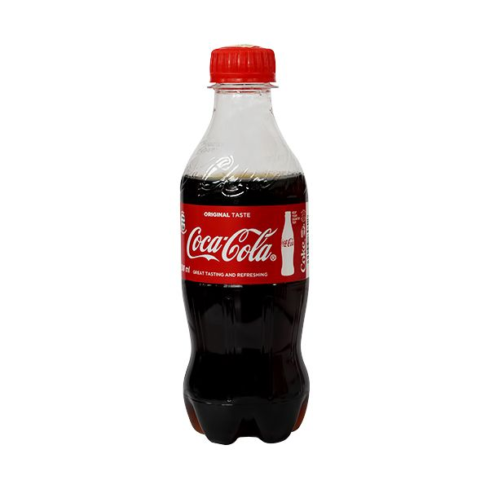
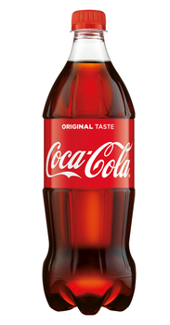
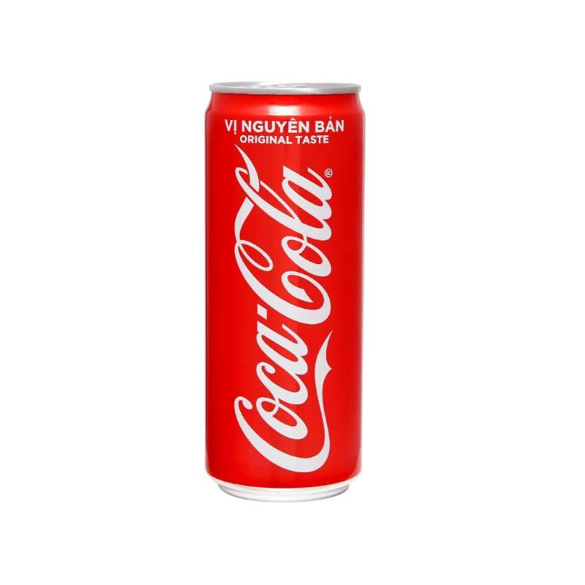
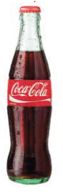


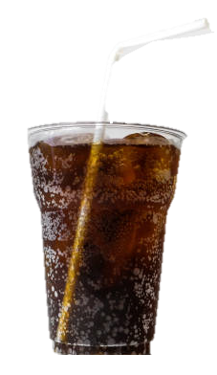
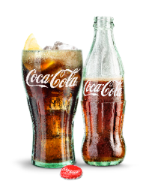
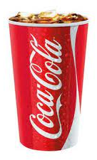
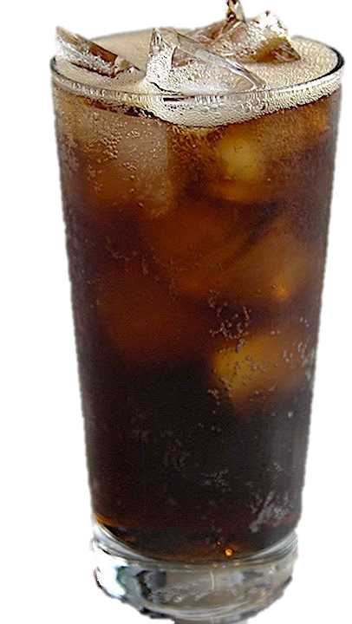

GLASS OPPORTUNITIES:
AFFORDABILITY & PREMIUMIZATION
ASP CONSUMERS BY SOCIOECONOMIC CLASS
1. AFFORDABILITY
LOW
PET
PET ASSP
CAN
RGB
|----|
MID
2. PREMIUMIZATION
HIGH
CURRENT
PERFECT SERVE WITH SOCIALIZATION BUNDLE
1 ASP consumers who are > 15 year-old

Slide 3

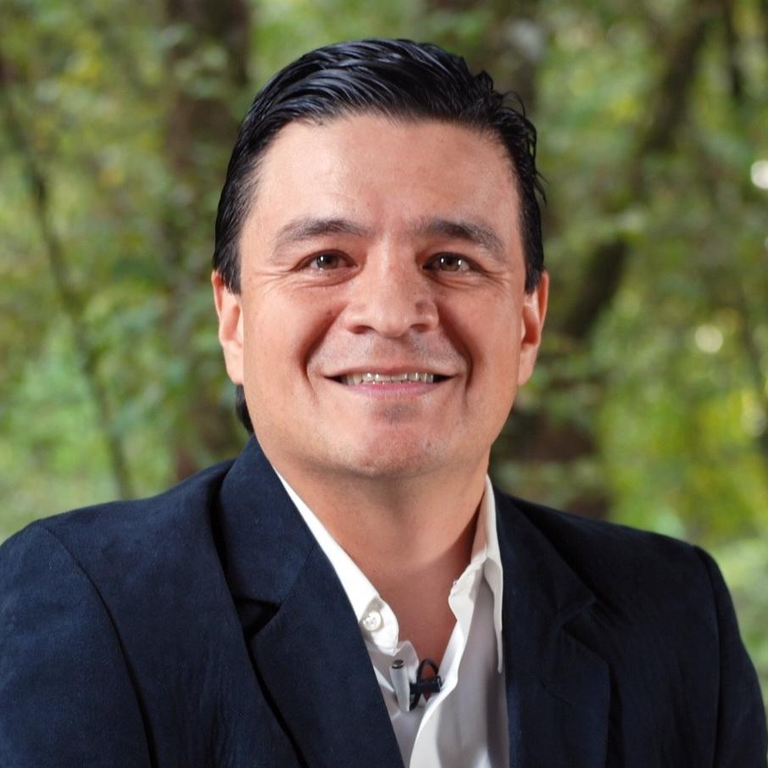
John Martinez
Director, Value to Market & Integrated Commercial Strategy
20+ years within the System
Global Refillable Leader
RTM & Commercial strategy | Stills business | RGM
Geography: LATAM (Mexico, Costa Rica)

Slide 4

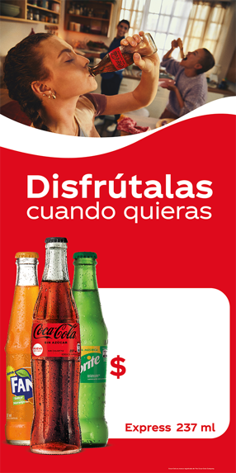
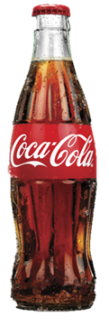
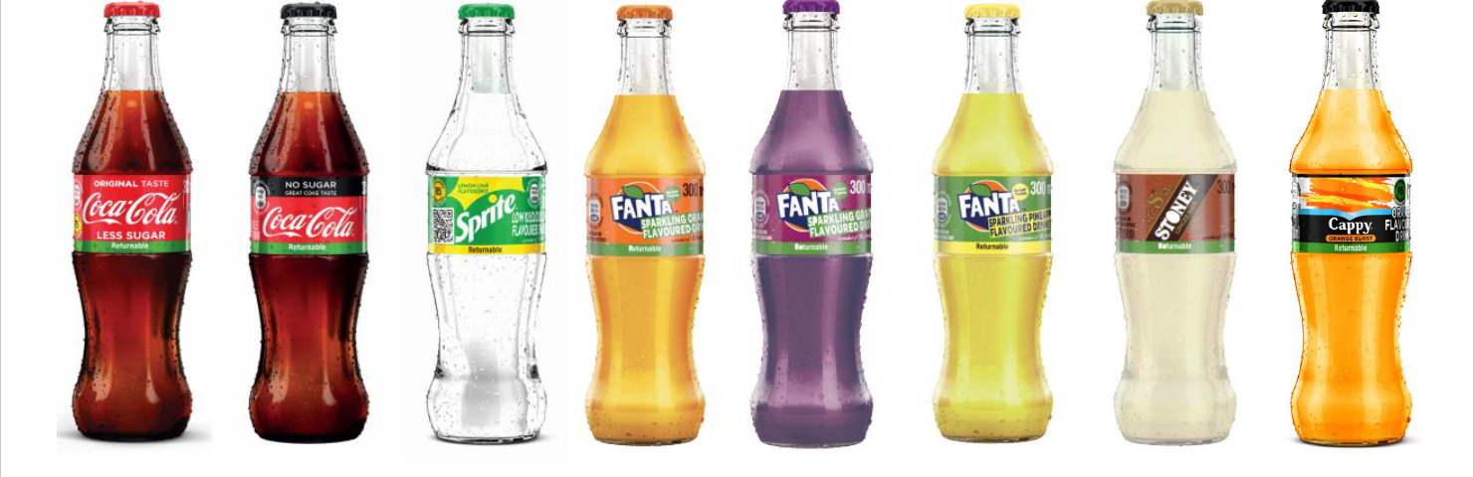
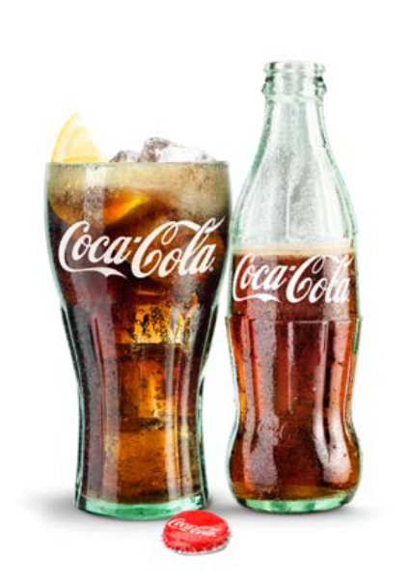
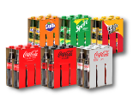
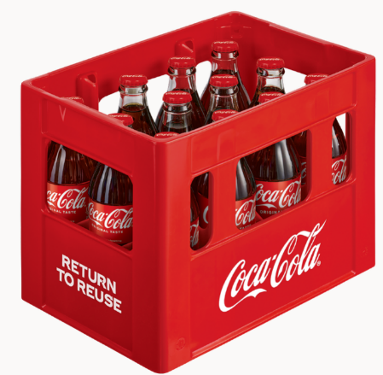
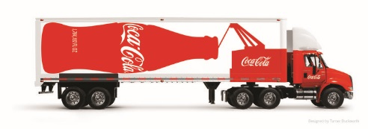
GLASS IS PROVEN TO BE A SUCCESSFUL RECRUITMENT ENGINE IN MANY MARKETS
COMPETITIVE ADVANTAGE
Protect our Base – high barrier to entry
CONSUMER PERCEPTION
Good for the pocket, Good for the Planet, Good for Me
CATEGORY EXPANSION
Recruitment through the experience (Contour), sustainability and through better price points for Affordability.
Build Habit and improves Frequency of Consumption, as packages serve as a constant purchase reminder
SUSTAINABILITY
Reutilizing minimizes carbon footprint and plastic waste – World Without Waste
Chile
Philippines
South Africa
AFFORDABILITY
Markets with Affordable Solutions have disproportionally higher rank on Per capita
2X Buying Frequency Households with Returnables 9.6 times vs 4.1 in OW
2X Tx during COVID; Implement Universal Bottle in 2024 onwards
Recover +3pts on value share with +21% vol growth
PERFECT SERVE
Germany
Hong Kong
Spain
Every market with Glass Mix above 10% has a Coke Brand Love Score above 3.0
Reversed the 7-year trends of RGB and grew net price by 7.1%
RGB Margin Growth with Premiumization at Home while addressing Sustainability
3.5x Volume Growth to capture Meals headroom

Slide 5

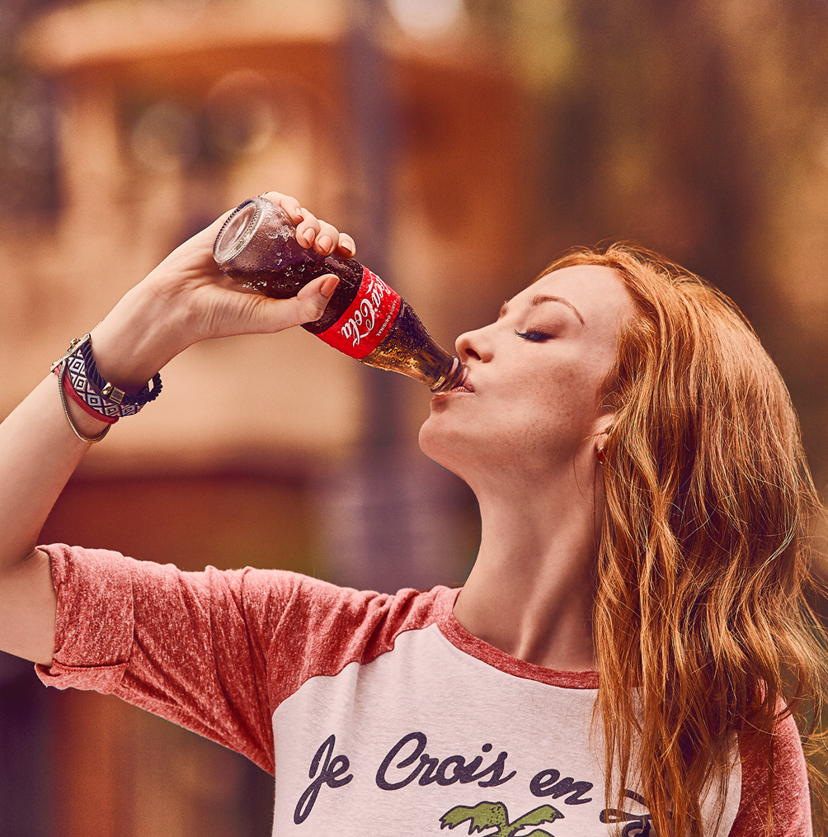

IN SUMMARY, MARKETS HAS BUILT RGB EDGE THROUGH INTEGRATED SYSTEM EFFORT
Powered by the brands´ Equity
RGB’s EDGE
Smart shopper
Affordability
Best consumption experience
“Iconic” experience
Better for the environment
Relevance
Uniqueness
Glass Edge is not only about the bottle
…but about the whole value proposition, powered by the Brand’s attributes and Equity, which makes it appealing and relevant to consumers.

Slide 6


TWO CASE STUDIES FOR TODAY
01
Driving the sustainable magic price point to recruit mass consumer base
02
Reset RTM together with clear consumer & trade support to drive premiumization in HoReCa

Slide 7
South Africa - Recruitment
South Africa
Driving the sustainable magic price point to recruit mass consumer base

Slide 8
South Africa heavily reliant on the SEC A consumption for revenue and profitability
South Africa pop. Living standards
SSD
Per Caps
System
Net Revenue
System
EBIT
Projected
3Y CAGR
745
64%
70%
+2%
High
13.3Mn
(24%)
29.1Mn
(53%)
145
29%
23%
+3%
Medium
12.6Mn
(23%)
124
7%
7%
+16%
Low

Slide 9
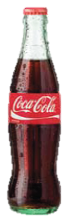
In SS, 300 RGB was the aligned solution for affordable recruitment @ R5
Entry Pack price is globally recommended @ 3%-5% vs DDI
LSM B+C
Population 76%
Daily Inc. R105.41
DDI
3% 5%
R 3.16 - R5.27
PROS | CONS | WHAT IS NEEDED?
Glass better experience Returnable strategy for emerging markets with affordability solutions Sustainable way to achieve right price point No Pet Levy Risks | Limitation for on the go occasion Channel expansion limitation R429 legislation | Launch Zero versions Price compliance: Change glass float to paper label Assess bottle and crate investment Numeric distribution to 90%

Slide 10
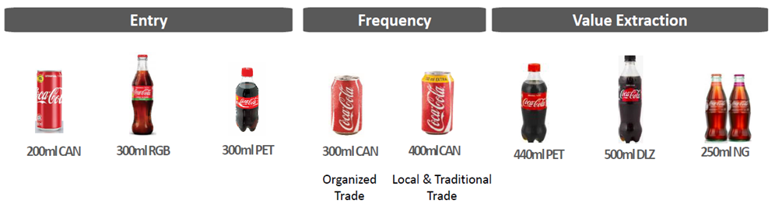
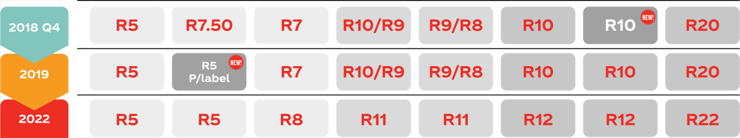
SA’s new Pack Price Architecture -
Immediate Consumption

Slide 11
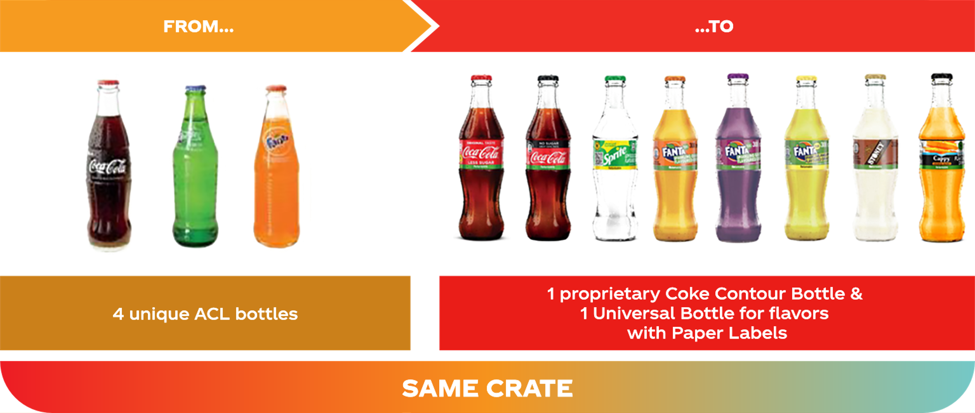
  The RGB bottles was transitioned from ACL proprietary bottles to universal design

Slide 12
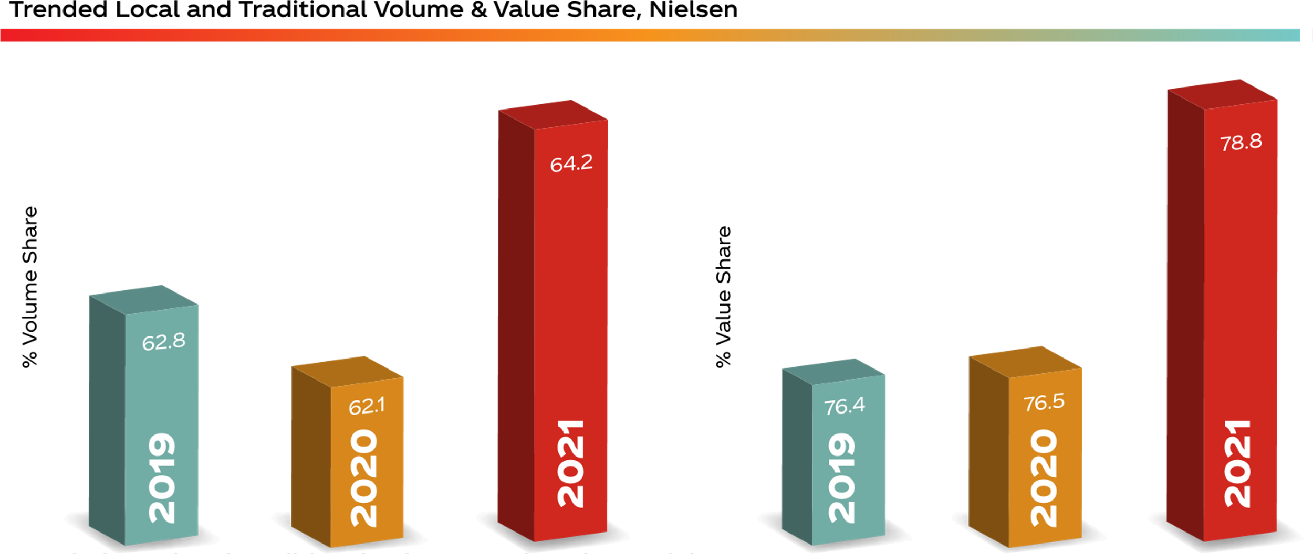
The Affordable Strategy has resulted in overall Local and Traditional share gains in 2021…

Slide 13

SUMMARY OF ACHIEVEMENTS & LEARNINGS
ACHIEVEMENTS
LEARNINGS
21.5% Volume growth Swing
Recovered Value Share (79.2) +3 points vs 2019
Stronger Pack / Price Architecture with mix of refillables & one-way packs
RGB as a tool to achieve 5 RND (5% of DDI)
Universal bottle to drive flavors & Stills
Price point compliance through paper label
Clear communication strategy with POSM & deposit schemes
Highly committed level of investments within System (8 new lines) which are currently running close to capacity
01

Slide 14
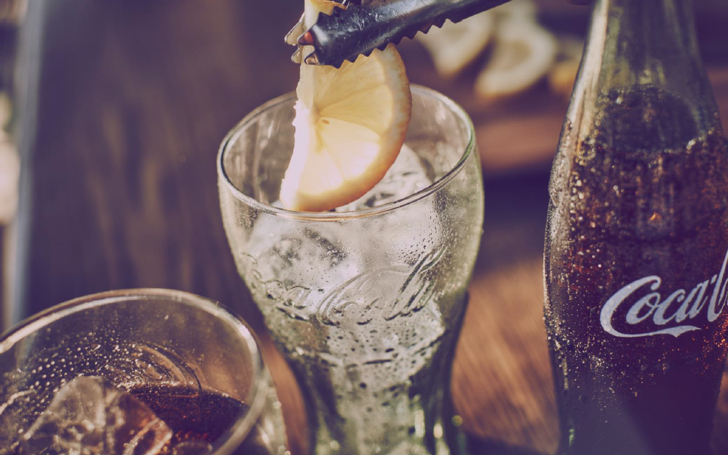
South Africa - Recruitment
HORECA IBERIA
Reset RTM together with clear consumer & trade support to drive premiumization in HoReCa

Slide 15


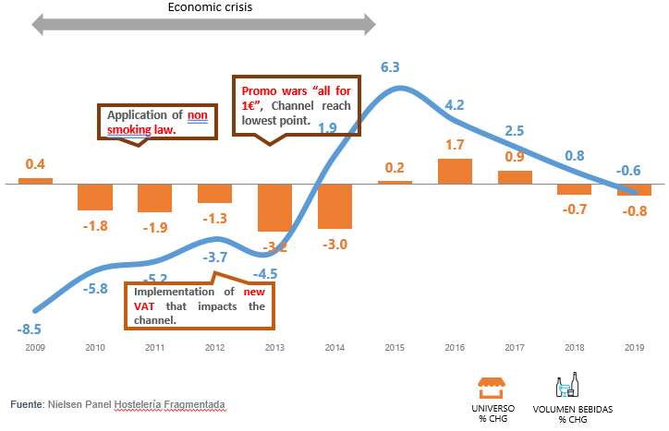
Horeca Spain industry in a nutshell
HORECA is a key channel for Iberia
Drives revenue growth in value and is critical for recruiting
new consumers
Horeca Outlets Universe
Spain
Source of Profit, Spain 2019
Vol
NSR
220.000
Value
KO NARTD Share 
80% Glass
Channel particularly fragile in times of crisis
and suffering a big transformation in the past years
 50.000 Outlets
 15.000 Outlets

Slide 16



Spain new RTM is founded to support HORECA and its development
350ml
RGB 300
B Bares
Llega Ella
8oz.
CDEs
RTM
WR
C&Roll
Creciendo
Meals
Segmen
Euro16
Bartender
IMC17
Football
Mix
Glass 2017
Screens
HORECA PUSH 
2013 onwards
2016 onwards
VALUE DRIVEN RTM
Outsourced: WH, order taking and delivery to partner distributors (beers)
Within CCP: Invoicing, Activation and Development
New Customer Segmentation
Aspirational Picture of Success
PicOS Achievement
94%
25 SKUs
20 SKUs
13 SKUs
Gold
OUTCOME
Silver
RED Coverage
Bronze

Slide 17
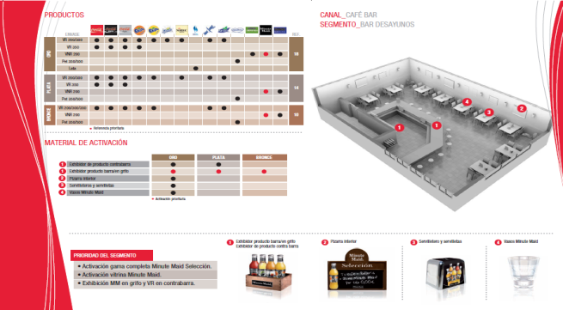


…with a picture of success has been defined for every trade segment
PRIORITY PORTFOLIO
Top SKUS Secondary SKUs
PiCoS
EXHIBITIONS
Displays POP Materials
COLD DRINK EQUIPMENTS
8 variables tracked related with its status

Slide 18
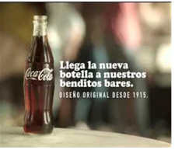
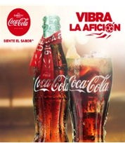
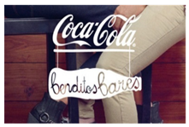
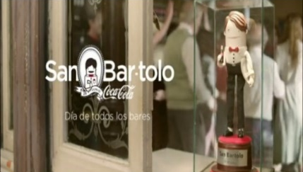
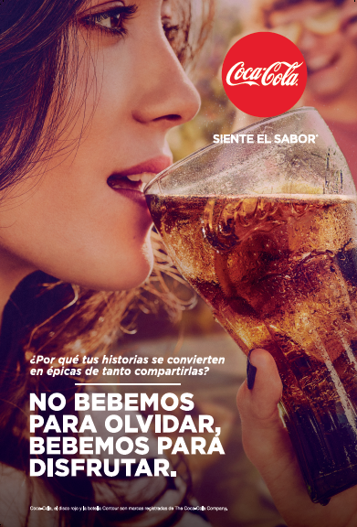
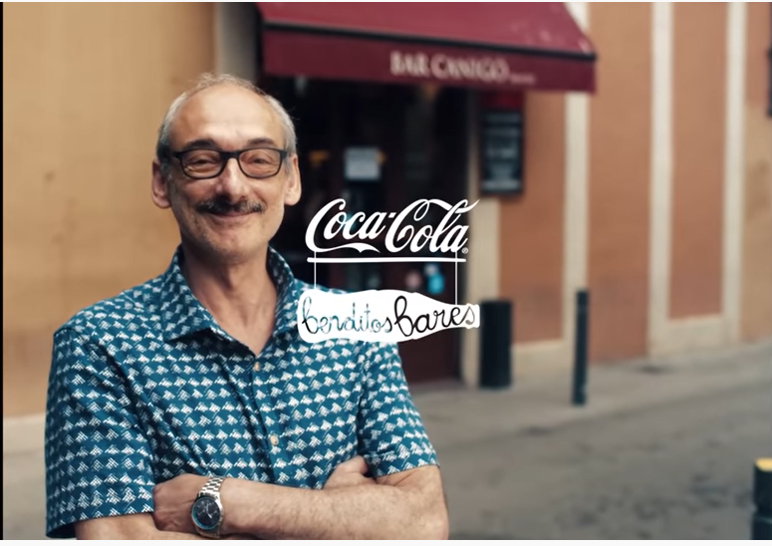

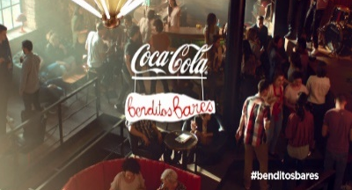
…with Integrated Marketing Campaigns to support RGB and HORECA
350ml
RGB 300
B Bares
Llega Ella
8oz.
CDEs
RTM
WR
C&Roll
Creciendo
Meals
Segment
Euro16
Bartender
IMC17
Football
Mix
Glass 2017
Screens
HORECA PUSH 
2013
INV: 5.950K€
2014
2015
INV: 4.941K€
2016
HIGH PROFILE ATL FOR HORECA
Benditos Bares
“Holy Bars”
Holy Bars 2
“St Bartholomew”
8oz Launch
“Complaints”
Euro 2016
2017
2018
INV: 4.321K€
2020
INV: 5.950K€
Horeca Perfect Serve
“Don’t Drink to Forget
Drink to Enjoy”
We’ll come back… to enjoy our bars

Slide 19
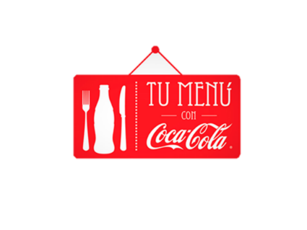
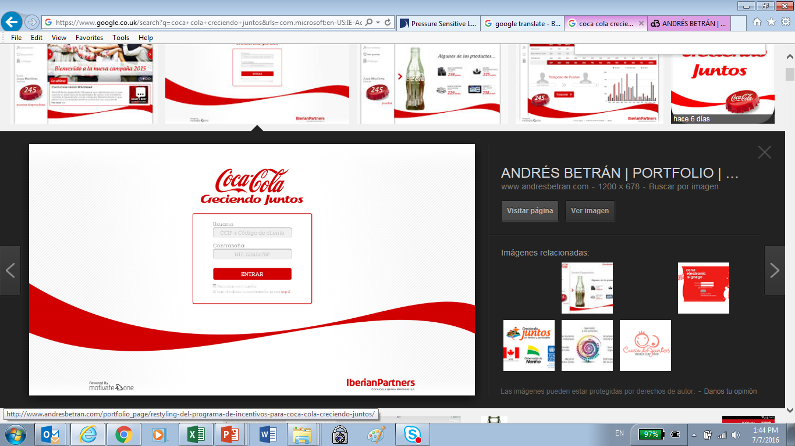



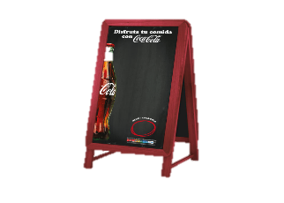

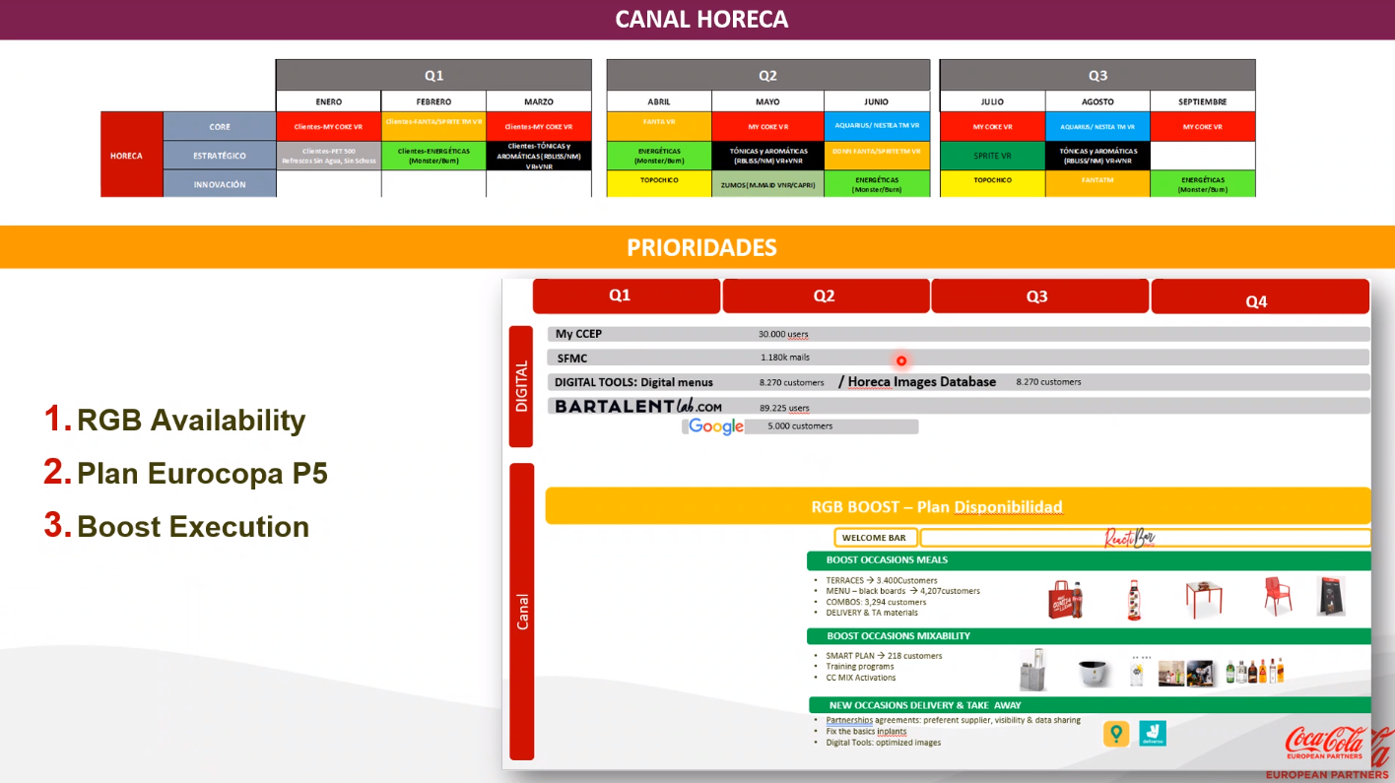

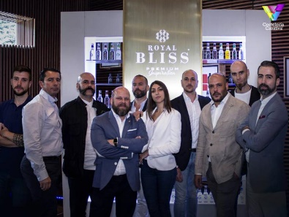
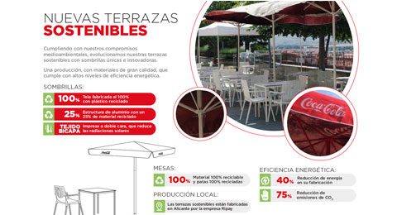






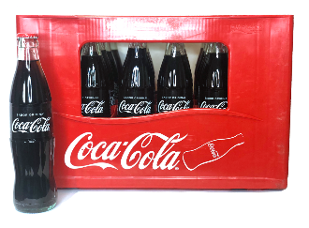







…Leading trades with sustained commercial programs to build consumer occasion
350ml
RGB 300
B Bares
Llega Ella
8oz.
CDEs
RTM
WR
C&Roll
Creciendo
Meals
Segmen
Euro16
Bartender
IMC17
Football
Mix
Glass 2017
Digital Horeca
HORECA PUSH 
+4.200 outlets Blackboards*
3.300 custom w/ Combos 
+10.000 outlets 
+220 outlets* 
2015-Today
2015- 2019
10 M€//Y
20.000 CDEs/Y
Occasion based marketing
Meals
(Activation Program)
CDEs
Customer Loyalty Program
Football Program
Mixability Program
(Activation Program)
2014-Today
2017- Today
2010-2019
2021- Today
2021-Today
Gente de Acción + 4coke
Listing & Availability Focus
Ambassadors / The Crew
Terraces program
Cliente Completo
Welcomebar & Reactibar
3.400 customers* 
1.600 customers* 

Slide 20
SUMMARY OF ACHIEVEMENTS & LEARNINGS
ACHIEVEMENTS
LEARNINGS
Reversed the 7-year trends of RGB and grew net price by 7.1%
41% of Countries NSR comes from Returnable Glass Bottle
Consistent in Package communication (Training, Integrated MKT Campaigns, Picture of Success Execution, Compensation)
Perfect Serve creating Superior Experience for RGB
Select Carefully Partner Distributors (High Numeric Distribution of essential SKUs for the Channel)
02

Slide 21
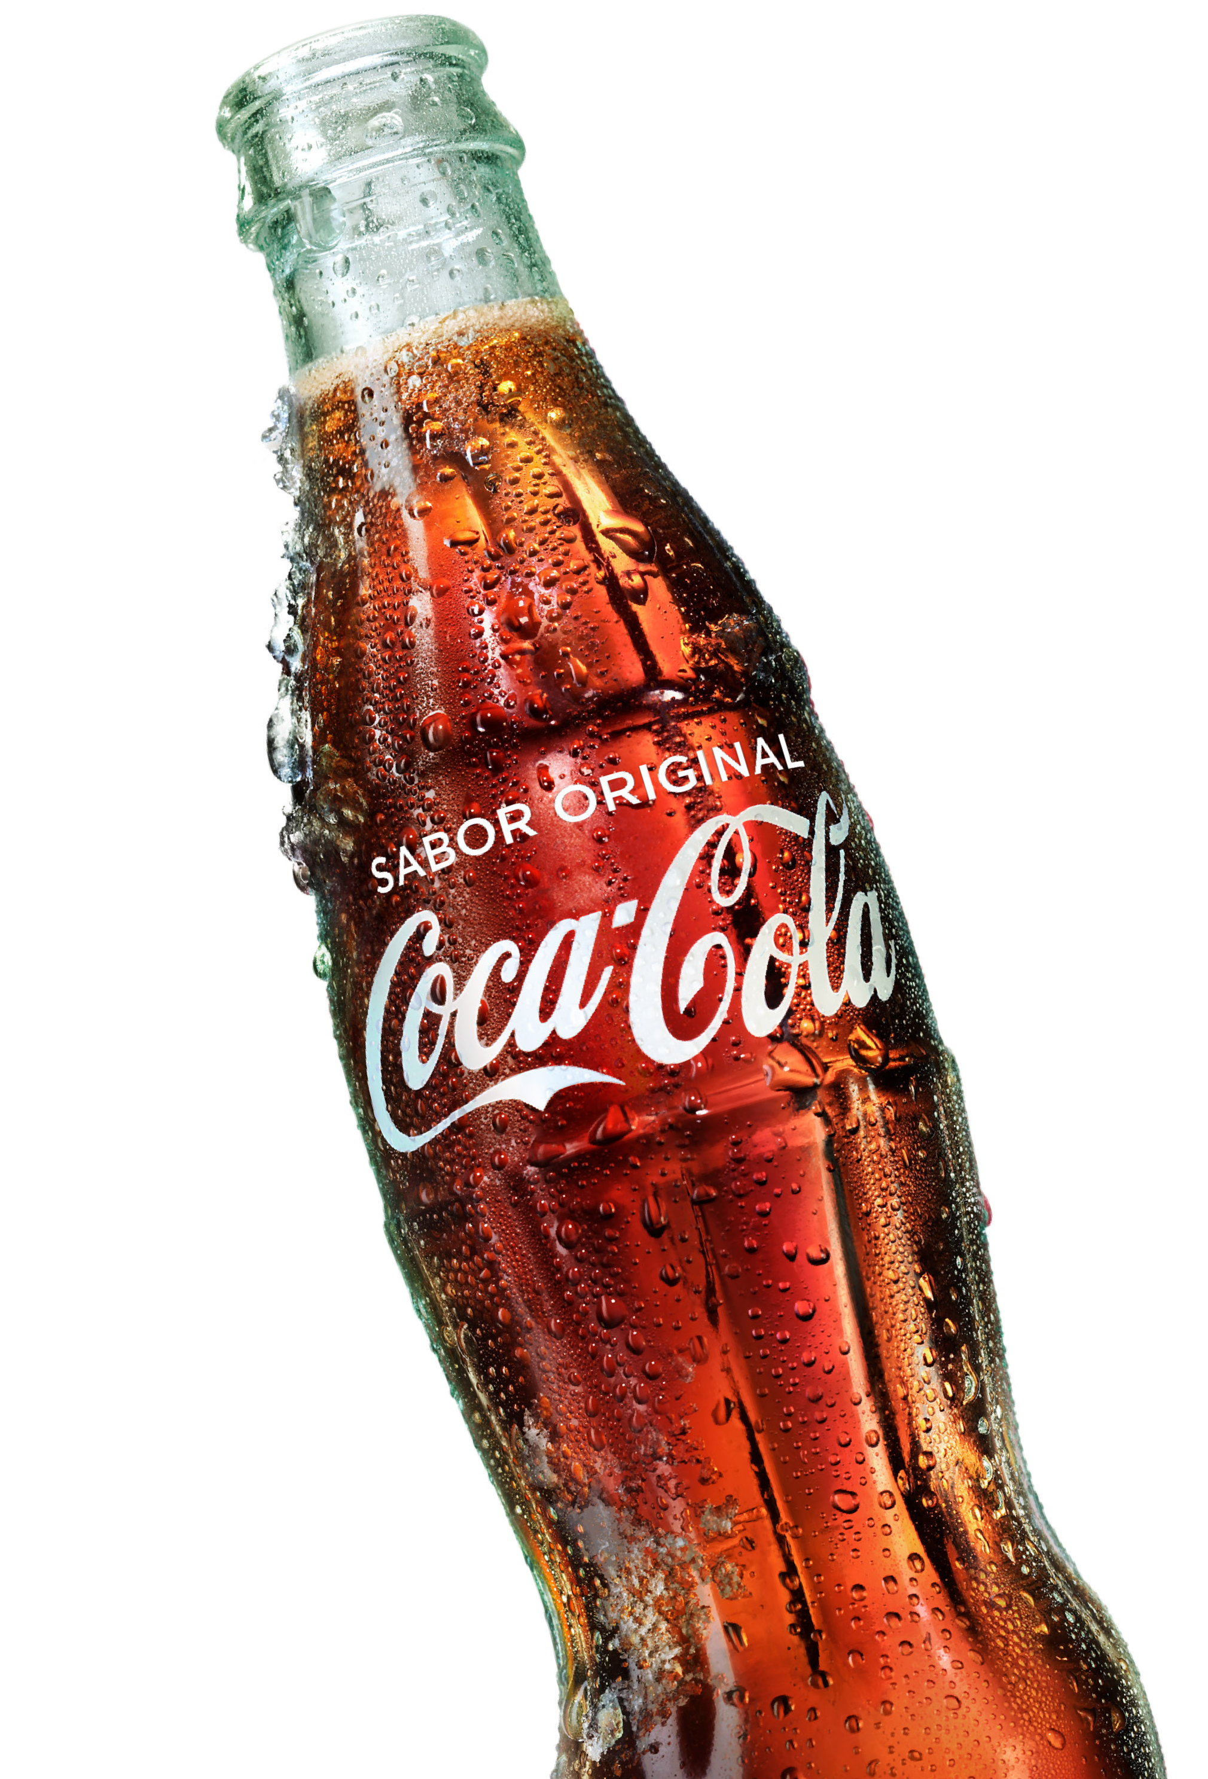
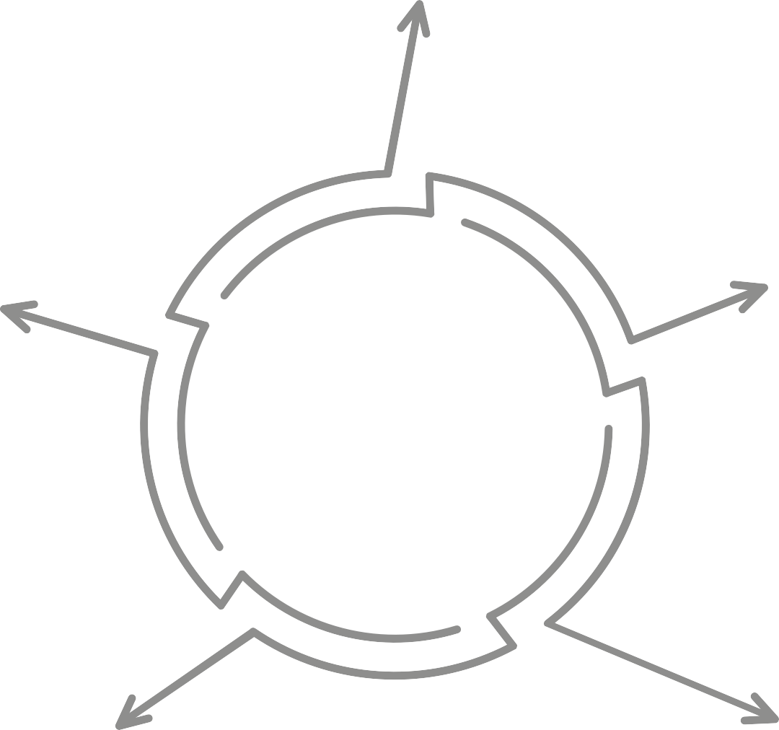


Key to Success: System Alignment and a holistic approach with long term consistency and investments commitments
01
Winning in Glass
VALUE DRIVEN RTM
Hybrid direct sales model focused on the value creation tasks.
05
ENABLERS
Leverage tools for scalability
Build credibility with stakeholders
02
PORTFOLIO & OBPPC PRIORITIZATION
Sustained bet on RGB across portfolio
PILLARS TO WIN
in Returnable Glass
04
VISIBILITY IN THE PATH TO PURCHASE
Consistent trade activation programs around drinking moments rituals showcasing consumption experiences
03
MARKETING PLATFORM
Consistent consumer Campaigns to support

Slide 22




Discussion
Notes:
Vision – AFFORDABILITY + PREMIUMZATION
Strategy – opportunity mapping (channel segmentation, regional segmentation)
Plans: Investment
Business cases
Integrated solutioning: Tools + How
NEXT STEPS:

